Slide 1
MODULE 3
Regularization & Optimization for Deep Learning
Making Neural Networks Learn Smarter, Not Harder

Slide 2
AGENDA
Regularization for Deep Learning:
Parameter Norm Penalties - L2 Parameter Regularization
Dataset Augmentation
Semi-Supervised Learning.
Optimization for Training Deep Models:
1. Challenges in Neural Network Optimization – Ill Conditioning, Local Minima, Plateaus, Saddle Points and Other Flat Regions.

Slide 3
MEMORIZATION VS UNDERSTANDING
Memorization
Overfitting
Understanding
Generalization

Slide 4
WHAT DOES NEURAL NETWORK LEARN?
Training Data
Neural Network
Learn Patterns
Prediction
Generalization
New / Unseen Data
The ability of a model to perform well on unseen data.

Slide 5
TRAINING ERROR VS TESTING ERROR
ERROR WHILE TESTING MODEL
ERROR WHILE TRAINING MODEL

Slide 6
UNDERFITTING-MODEL IS TOO SIMPLE
TRAINING PERFORMANCE
POOR
TESTING PERFORMANCE
POOR

Slide 7
GOOD FIT
ERROR WHILE TESTING MODEL
GOOD FIT
ERROR WHILE TRAINING MODEL

Slide 8
OVERFITTING- MODEL IS TOO COMPLEX
ERROR WHILE TESTING MODEL
OVERFITTING
ERROR WHILE TRAINING MODEL

Slide 9
WHY DOES OVERFITTING HAPPEN?
Very complex model
Too many parameters
Small training dataset
Noisy data
Insufficient regularization
Excessive training

Slide 10
LET’S SEE OVERFITTING
Select a difficult dataset such as Spiral.
Use a relatively complex network.
Keep regularization OFF.
Train the network.
Observe the decision boundary.
Compare training and test performance.

Slide 11
FROM OVERFITTING TO REGULARIZATION
Regularization is a technique used to reduce overfitting by controlling the complexity of a machine learning model and improving its ability to generalize to unseen data.
REGULARIZATION
GOOD GENERALIZATION

Slide 12
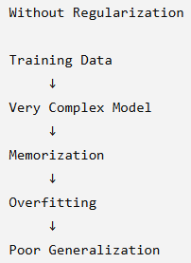
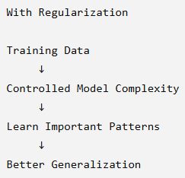
HOW DOES REGULARIZATION HELP US?

Slide 13
WHY WE NEED OPTIMIZATION & REGULARIZATION
1. Neural Network:
"Our network receives input and makes a prediction."
2. Loss:
"How wrong was our prediction?"
3. Backpropagation:
"Which weights are responsible for the error, and in which direction should they change?"
4. Optimization:
"Okay, we know the direction. But HOW MUCH should we change the weights?"

Slide 14
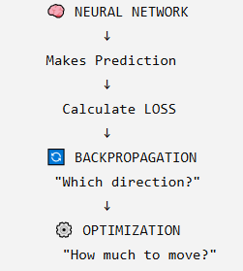
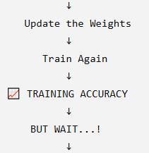
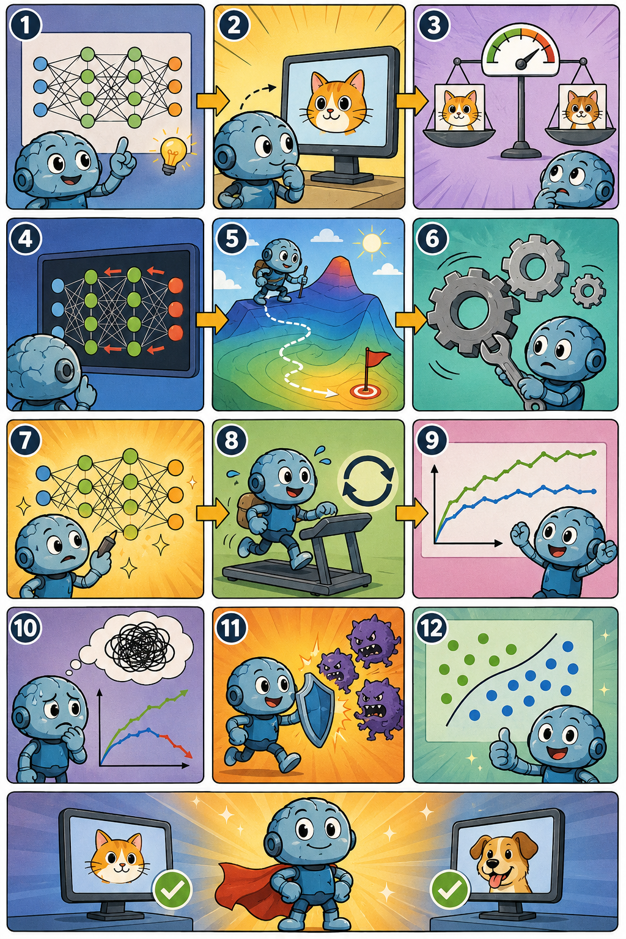
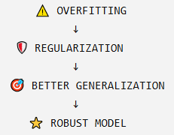


Slide 15
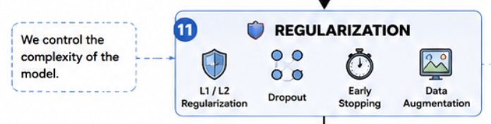

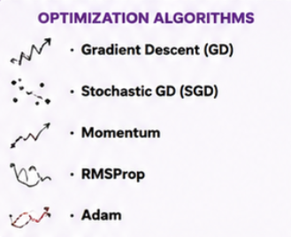

Slide 16
REGULARIZATION TECHNIQUES
Technique | Basic Idea
L1 Regularization | Penalizes absolute values of weights
L2 Regularization | Penalizes squared values of weights
Dropout | Randomly deactivates neurons during training
Data Augmentation | Creates varied training examples
Early Stopping | Stops training before the model starts overfitting

Slide 17

Parameter Norms & Penalties
What is a parameter norm penalty?
Neural network has many parameters:
$$W=\left\{w_{1} , w_{2} , w_{3} , … , w_{n}\right\}$$
Regularization adds a penalty to the loss when the weights become large.
Instead of minimizing only:
$$J\left(W\right)$$
we minimize:
$$J_{regularized}\left(W\right)=J\left(W\right)+λΩ\left(W\right)$$
Where:
$J_{regularized}\left(W\right)$ = Total error cost
$J\left(W\right)$= original loss (Avg Training Error)
$Ω\left(W\right)$= penalty term
$λ$= regularization strength

Slide 18
Why Penalize the weights?
Large weights
OVERFITTING
Parameter penalties
Unnecessarily increase large weights
Control Model Complexity

Slide 19


L1 & L2 REGULARIZATION
L1 Regularization
Ω(W)=$\text{∑​∣w}\text{i}\text{​∣}$
Therefore:
J_{L1}​= J + λ∑​∣w_{i}​∣
Ω(W)=$\text{∑​w}\text{i}\text{​}$²
Therefore:
J_{L2}​= J + λ∑$\text{w}\text{i}\text{​}$²​​
L2 Regularization
Usually, the regularization is applied to the weights; biases are often excluded depending on the implementation.

Slide 20


Regularization Parameter λ
J_{L2}​= J + λ∑$\text{w}\text{i}\text{​}$²​​
λ controls the strength of regularization.
If λ = 0
$$J_{L2}=J$$
No regularization.
Small λ: Small penalty.
Large λ: Large penalty.

Slide 21
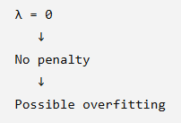
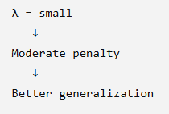
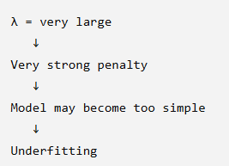
L2 does not tell the network to ignore the data
It tells the network to fit the data while also avoiding unnecessarily large weights

Slide 22
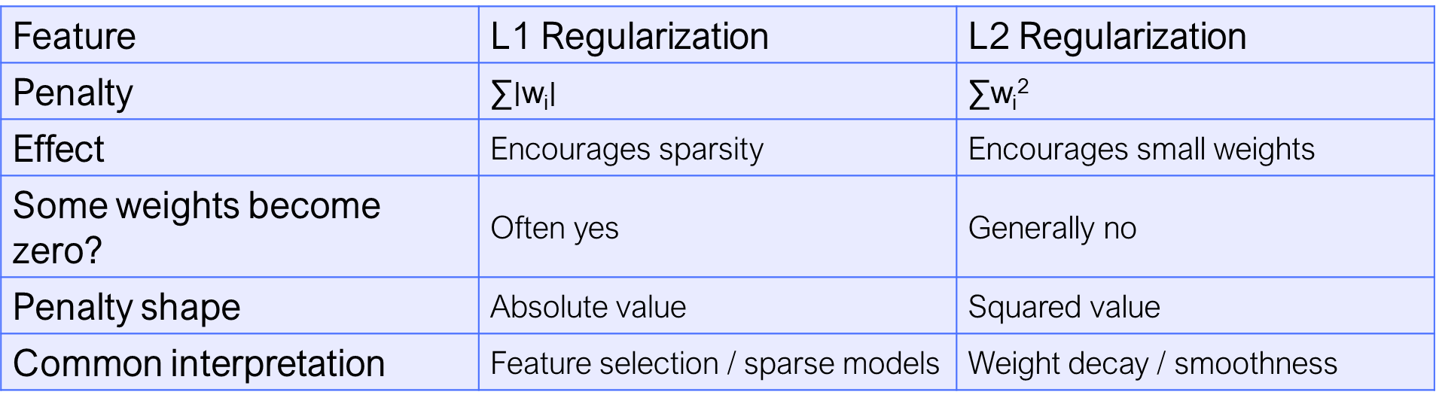
L1 vs L2
Feature | L1 Regularization | L2 Regularization
Penalty | ∑​∣w_{i}​∣ | ∑$\text{w}\text{i}\text{​}$²
Effect | Encourages sparsity | Encourages small weights
Some weights become zero? | Often yes | Generally no
Penalty shape | Absolute value | Squared value
Common interpretation | Feature selection / sparse models | Weight decay / smoothness

Slide 23
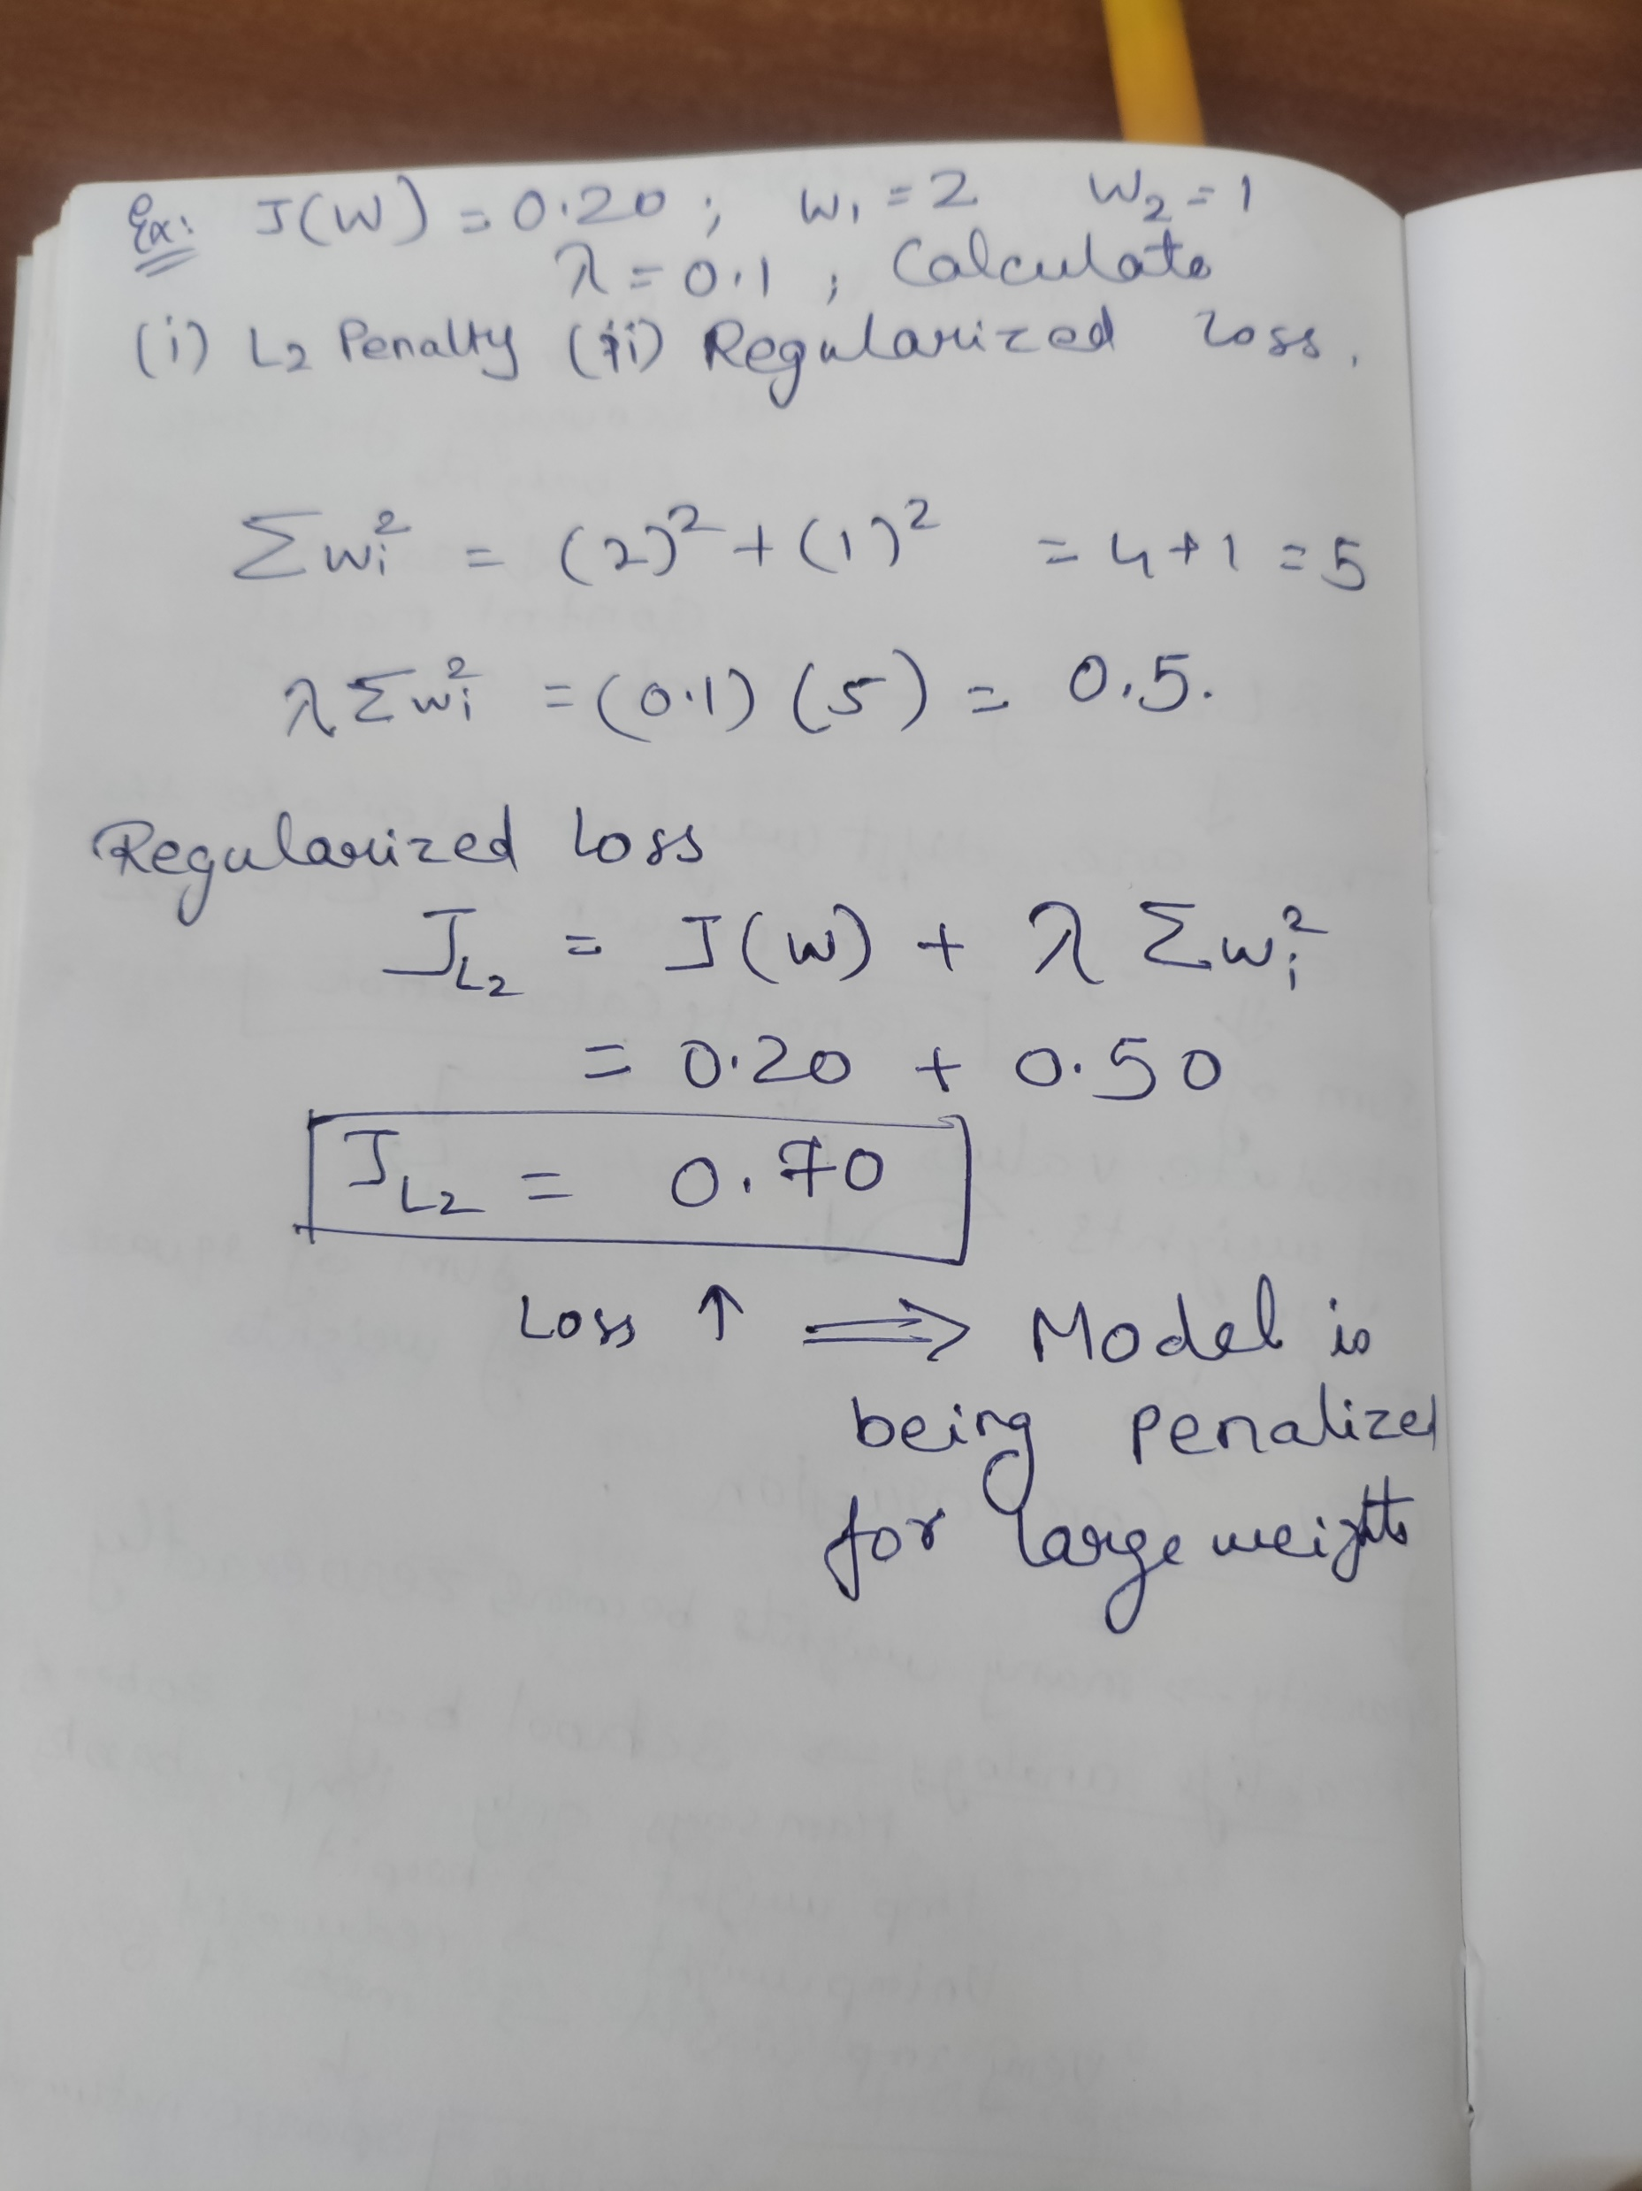
Numerical

Slide 24

L2 – WEIGHT DECAY
L2 regularization is closely related to the idea of weight decay because it encourages weights to become smaller during training
Weight decay encourages the model to reduce those unnecessary weights, just like reducing unnecessary items in a backpack.

Slide 25
L2 Parameter Regularization: How Does It Change the Weights?
Loss function
Gradient
Weight update

Slide 26


With L2 Regularization
J_{L2} (w)​= J(w) + $\frac{λ}{2}$∑$\text{w}\text{i}\text{​}$²
Minimize training loss + weight penalty
$\frac{λ}{2}$∑$\text{w}\text{i}\text{​}$²
NEW TERM ?

Slide 27
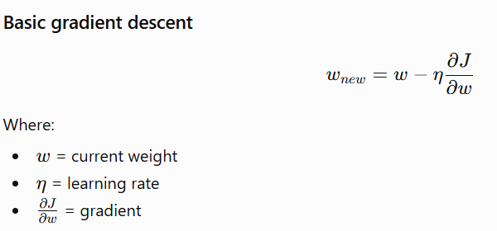
WHY DIFFERENTIATION?
Loss Function
↓
Calculate Gradient
↓
Determine direction of change
↓
Update Weights

Slide 28

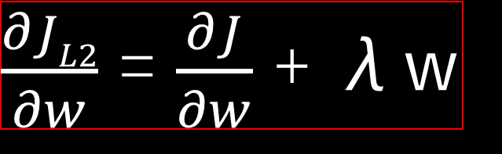

ADD L2
J_{L2} (w)​= J(w) + $\frac{λ}{2}$∑$\text{w}\text{i}\text{​}$²
Now differentiate with respect to $w$:
$\frac{∂JL2}{∂w}$ = $\frac{∂J}{∂w}$ + $\frac{∂ (\frac{λ}{2}\text{∑w}\text{i}\text{​}\text{2})}{∂w}$
$\frac{∂JL2}{∂w}$ = $\frac{∂J}{∂w}$ + λw

Slide 29
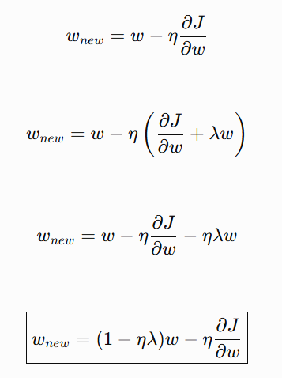
MODIFIED WEIGHT UPDATE
Normal Gradient descent
L2 Gradient descent

Slide 30
WHAT ACTUALLY HAPPENS TO WEIGHT?
Example: w=0.8 , λ=0.1
What if weight is negative?
w=-0.8
So, L2 contribution to the gradient is:
λw=0.1(0.8)=0.08
λw=0.1(−0.8)=−0.08
The L2 gradient contribution is negative.
During gradient descent,
So, L2 adds +0.08 to the gradient, but while updating it will be applying –η(0.08)
Positive weight → pushed downward toward zero.
negative weight → pushes the weight upward toward zero.

Slide 31
Positive weight
Negative weight
L2 pushes it ↓
L2 pushes it ↑
toward zero
toward zero
IRRESPECTIVE OF WEIGHTS IT PULLS/PUSHES THE WEIGHT TOWARDS THE ZERO

Slide 32
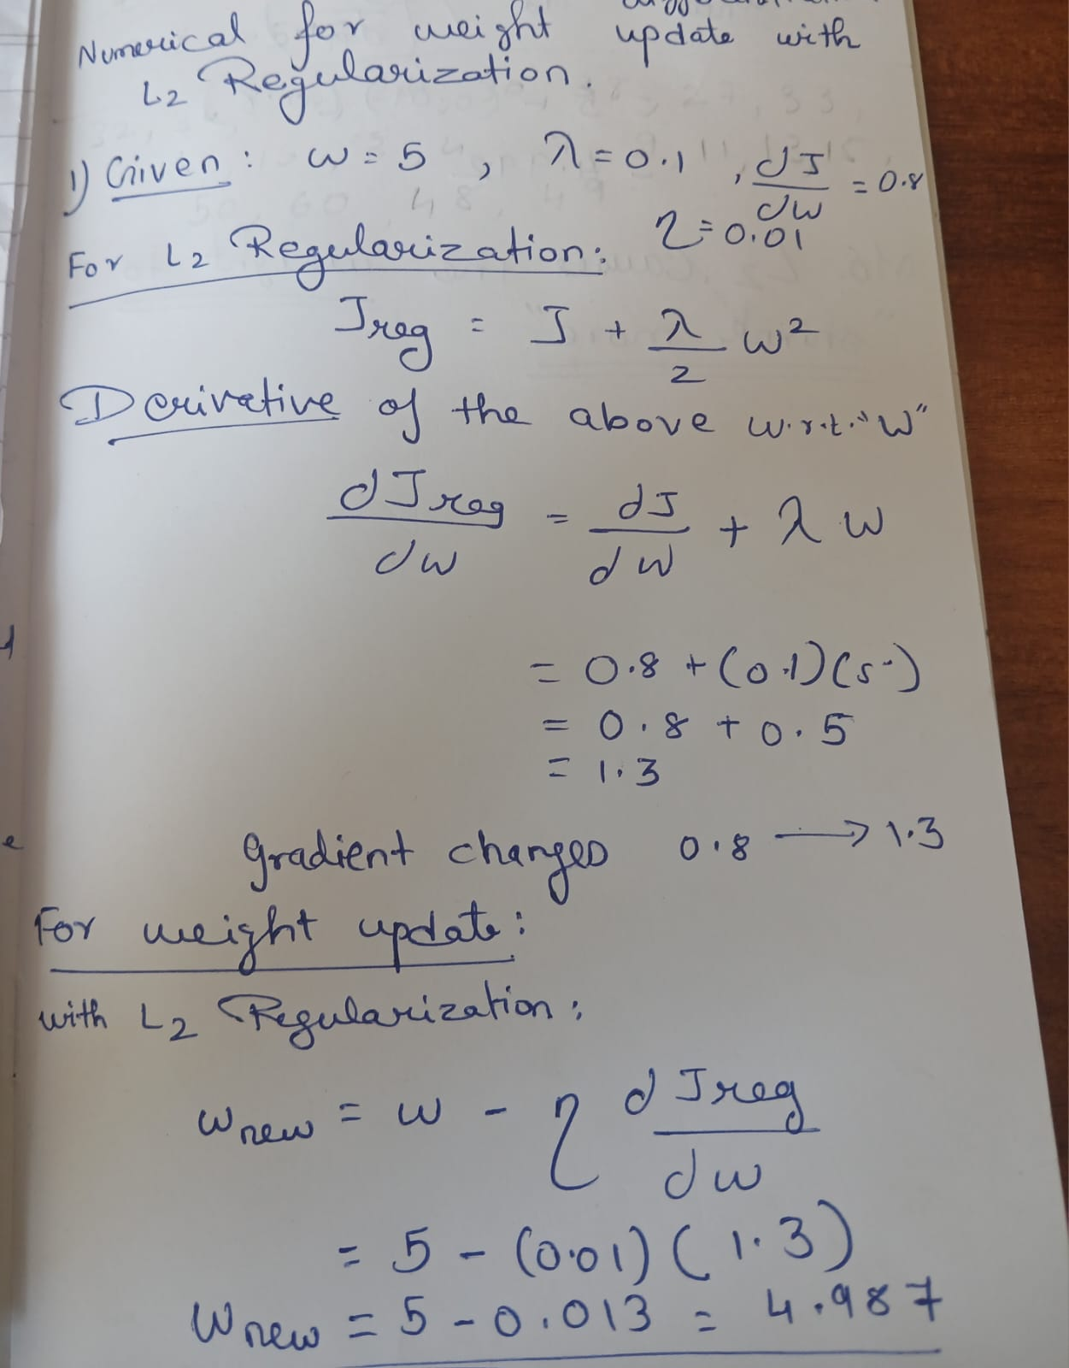
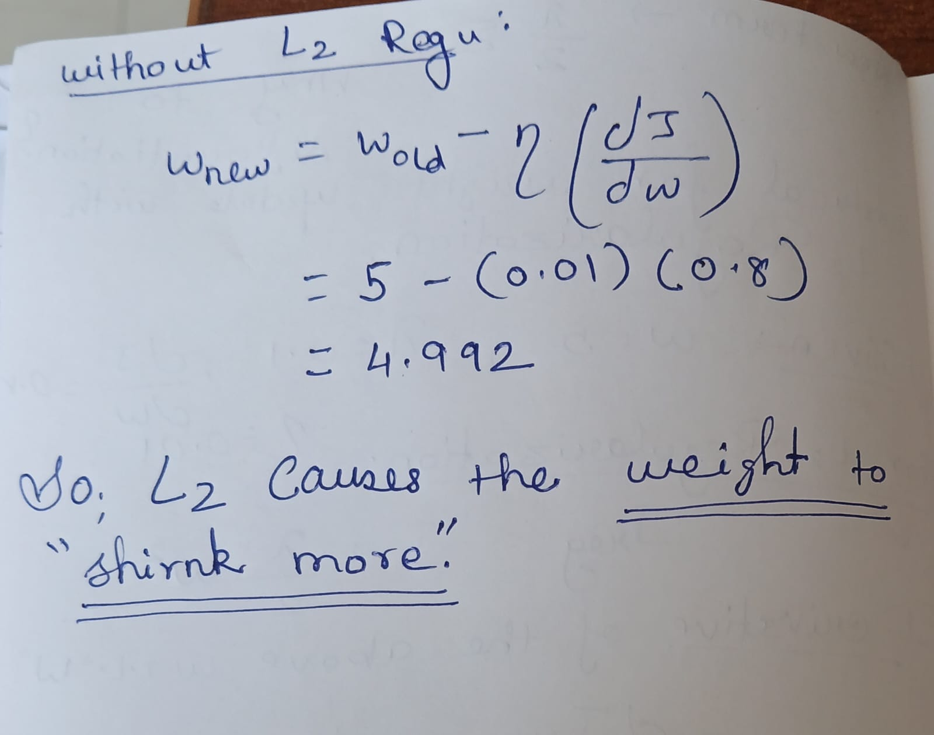
MODIFIED WEIGHT UPDATE NUMERICALS

Slide 33
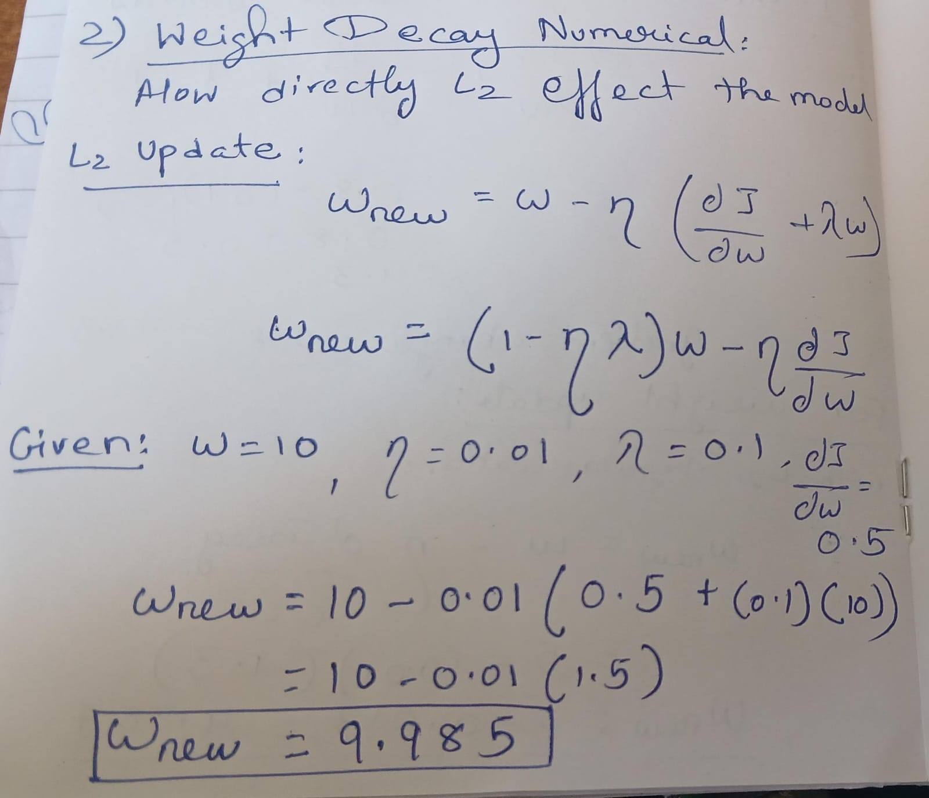
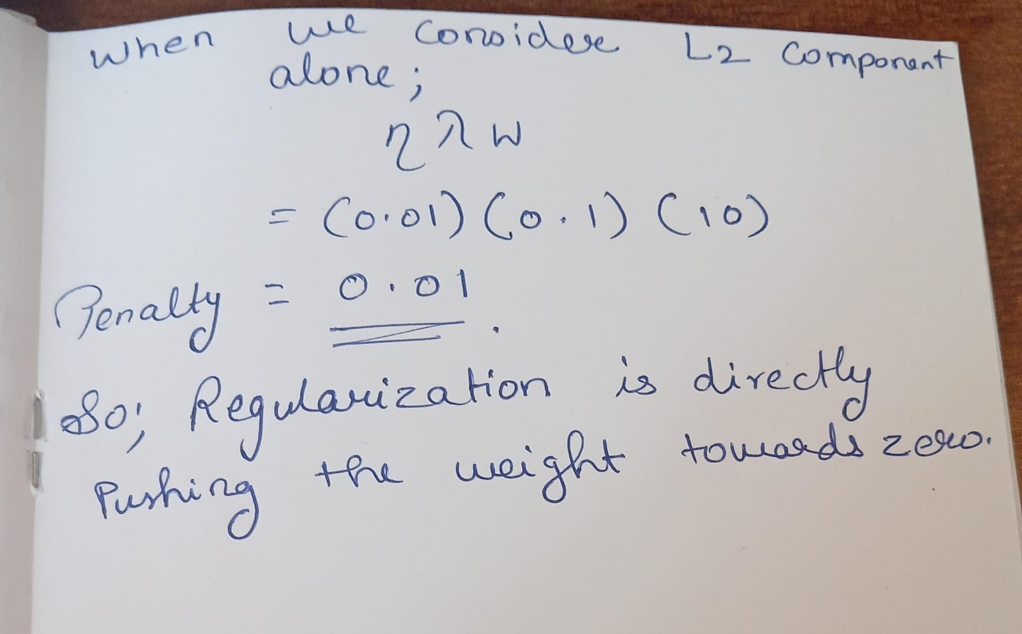

Slide 34
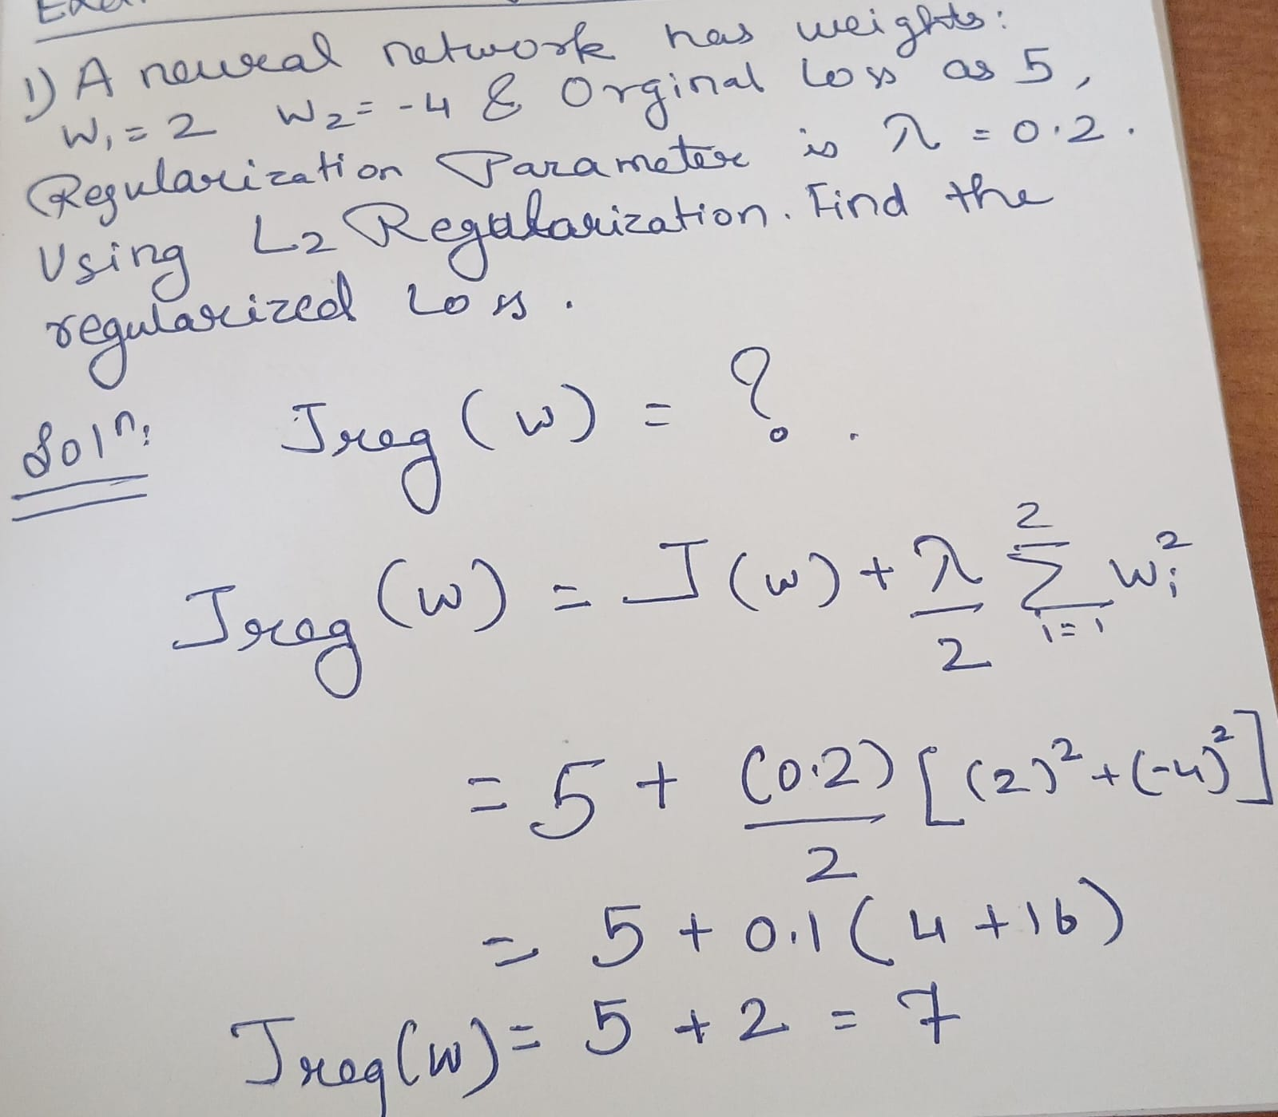

Slide 35
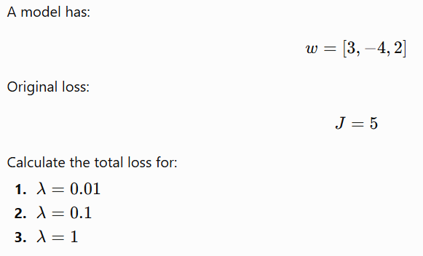
EXTRA NUMERICALS
Q1
Q2

Slide 36

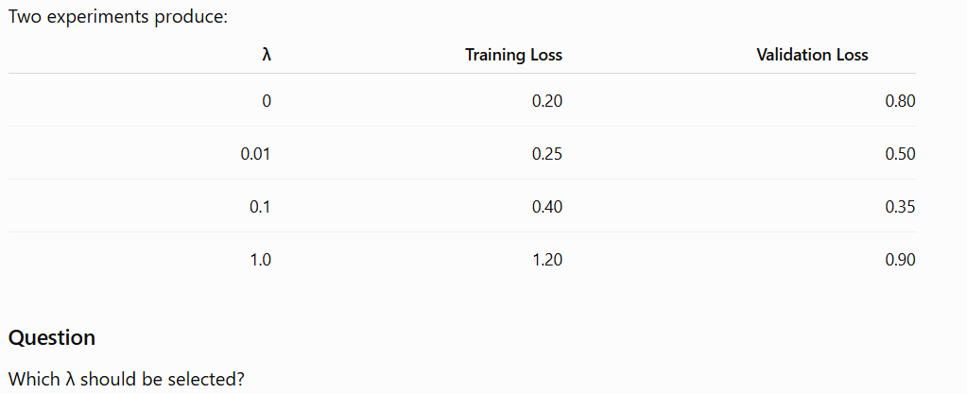
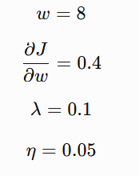



EXTRA NUMERICALS
Q3
Q2

Slide 37
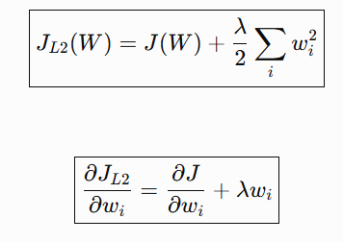
MOST IMPORTANT FORMULA FOR L2 REGULARIZATION WEIGHT UPDATE
2nd equation tells how L2 updates the weight

Slide 38
REGULARIZATION TECHNIQUES: DATA AUGMENTATION
More variety in data
Better generalization

Slide 39
CAN WE CHANGE THE TRAINING DATA?

Slide 40
The Problem: Limited Training Data
Limited Training Data
↓
Model sees limited variations
↓
Learns specific patterns
↓
Possible Overfitting

Slide 41
WHAT IS DATA AUGMENTATION?
Data augmentation is the process of creating modified versions of existing training samples to increase the diversity of the training data.
Original image
↓
Rotate
Flip
Crop
Zoom
Translate
Change brightness
Add noise
↓
New training examples

Slide 42



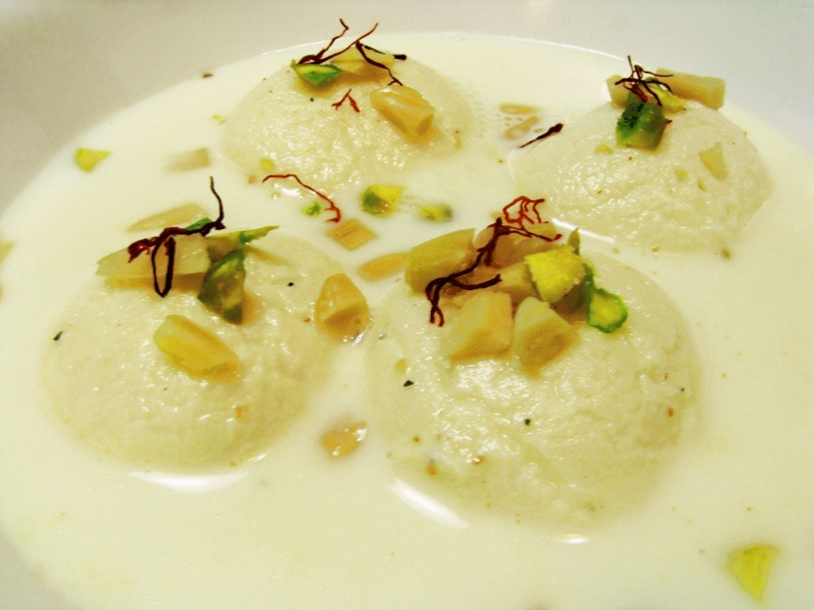




Slide 43
WHY DATA AUGMENTATION?
Without Augmentation | With Augmentation
 | Original Dataset ↓ Transformations ↓ More diverse training examples ↓ Model learns robust features ↓ Better Generalization
Small Dataset
↓
Limited variation
↓
Model memorizes patterns
↓
Overfitting

Slide 44
DATA AUGMENTATION TECHNIQUES
Technique | What happens?
Rotation | Rotates the image
Horizontal Flip | Mirrors the image
Vertical Flip | Flips vertically
Translation | Moves the object
Cropping | Removes part of the image
Zoom | Zooms in/out
Brightness | Changes illumination
Contrast | Changes contrast
Noise | Adds small disturbances
Shearing | Slants the image

Slide 45
DATA AUGMENTATION AS GENERALIZATION
Regularization
Techniques that help prevent overfitting and improve generalization.
Data augmentation does this by:
Increasing data diversity
↓
Reducing dependence on specific training examples
↓
Encouraging robust feature learning
↓
Reducing overfitting

Slide 46
Image Augmentation: What Should NOT Be Done?
Augmentation must preserve the label
Choose transformations according to the problem and the data
Data augmentation vs l2
L2 Regularization | Data Augmentation
Modifies the loss function | Modifies/expands the training data
Penalizes large weights | Creates varied training examples
Encourages smaller weights | Encourages robust feature learning
Controls model complexity | Improves data diversity
Mathematical penalty | Data transformation

Slide 47
Limitations | Advantages
Poor transformations can introduce unrealistic data | Reduces overfitting
May increase training time | Improves generalization
Not every transformation is suitable for every dataset | Useful when datasets are small Increases training-data diversity
Cannot completely replace real data collection | Can improve model robustness

Slide 48
RECALL ML TYPES , LABELLED , UNLABELLED DATA

Slide 49
SEMI-SUPERVISED LEARNING
Combination of a small amount of labelled data and a large amount of unlabelled data to learn a predictive model.
TRAINING DATA
LABELLED DATA
UNLABELLED DATA
LEARNING MODEL
PREDICTING

Slide 50
WORKFLOW
Small Labelled Dataset
Train Initial Model
Predict Labels for Unlabelled Data
Select Reliable Predictions
Use Them as Additional Training Information
Improve the Model

Slide 51
PSEUDO LABELLING
The label is not provided by a human. It is generated by the model, so we call it a pseudo-label
Unlabelled Image
↓
Model
↓
Prediction:
CAT
Confidence = 97%
The model can assign:
Pseudo-label = CAT

Slide 52






CONFIDENCE MATTERS
High-confidence predictions are generally safer to use as pseudo-labels than uncertain predictions.

Slide 53

CONNECTION TO REGULARIZATION
Semi-supervised approaches can use the structure/information present in unlabelled data to improve learning when labelled examples are limited.
REGULARIZATION
L2 Penalty
Semi- Supervised
Data Augmentation
Reduce Overfitting
Better Generalization

Slide 54

OPTIMIZATION FOR DEEP NEURAL NETWORKS
Optimization is the process of finding suitable values of model parameters (weights) that minimize the loss function
Suppose the network has weights:
$$W=\left[w_{1} , w_{2} , w_{3} , … , w_{n}\right]$$
The network produces a loss:
$$J\left(W\right)$$
Our objective is:
$$\boxed{\min_{W}J\left(W\right)}$$
Meaning:
Find weight values that give the smallest possible loss.

Slide 55
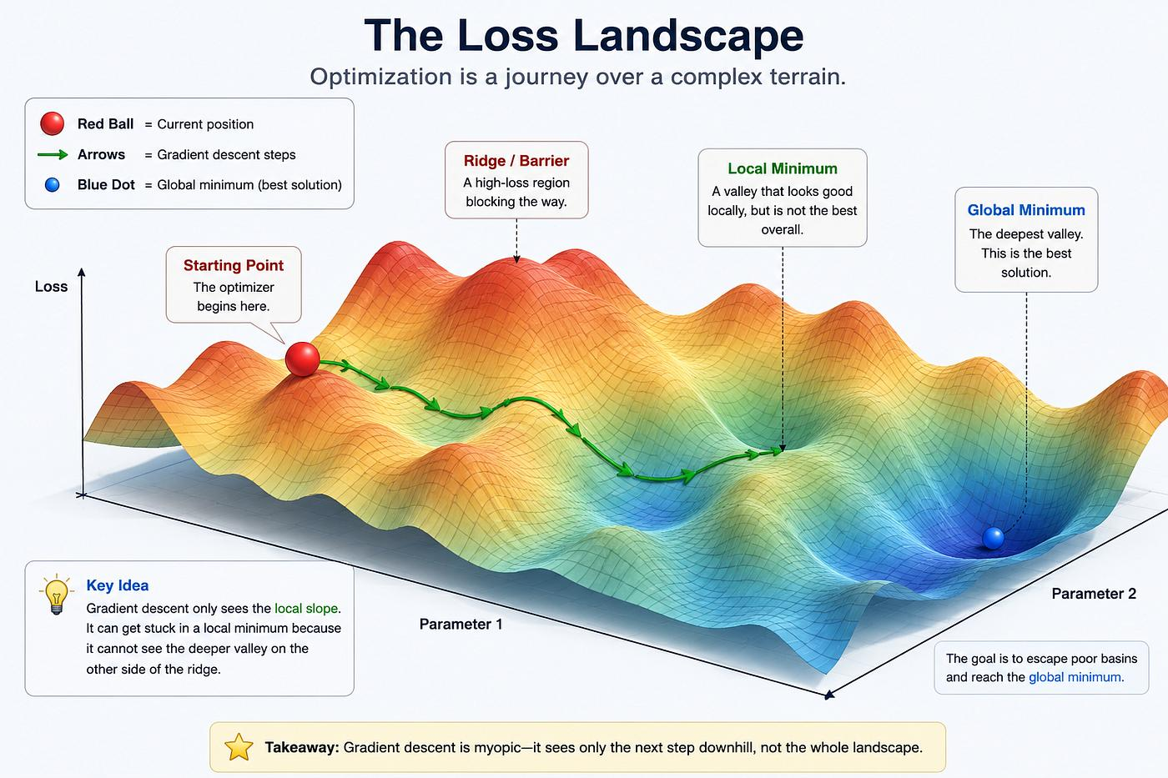

Slide 56
WHY WE NEED OPTIMIZATION?
A deep neural network may have : Thousands ,Millions ,Sometimes billions of parameters.
We cannot manually decide: which weight and how much to increase or decrease, so
An optimization algorithm automatically updates the weights.
Backpropagation: How does the loss change with respect to each weight?
Optimization: Decide how to update the weights to reduce the loss.

Slide 57
GRADIENT DESCENT

Slide 58
PROBLEM
ILL CONDITIONING
LOCAL MINIMA
Narrow, elongated valleys.
A small valley that may not be the global minimum.
PLATEAUS
SADDLE POINTS
Large regions where the gradient is very small.
Downward in one direction but upward in another.
OTHER FLAT REGIONS
Regions where optimization progresses very slowly.

Slide 59
ILL CONDITIONING IN NEURAL NETWORKS
A Challenge in Neural Network Optimization
“Why gradient descent take a long time even when it knows the downhill direction?”
RECALL Gradient Descent
Gradient tells us which direction decreases the loss. So we move in the opposite direction

Slide 60

ILL CONTIONING MEANING
In deep learning, we minimize a loss function $J\left(θ\right)$using gradients.
The loss surface can be:
Well‑conditioned: similar curvature in all directions
Ill‑conditioned: very different curvature in different directions (steep in one direction, very flat in another)
Ill‑conditioning makes gradient descent zig‑zag and converge slowly.
Ill conditioning is not a type of minimum. It describes the geometry of the optimization problem

Slide 61
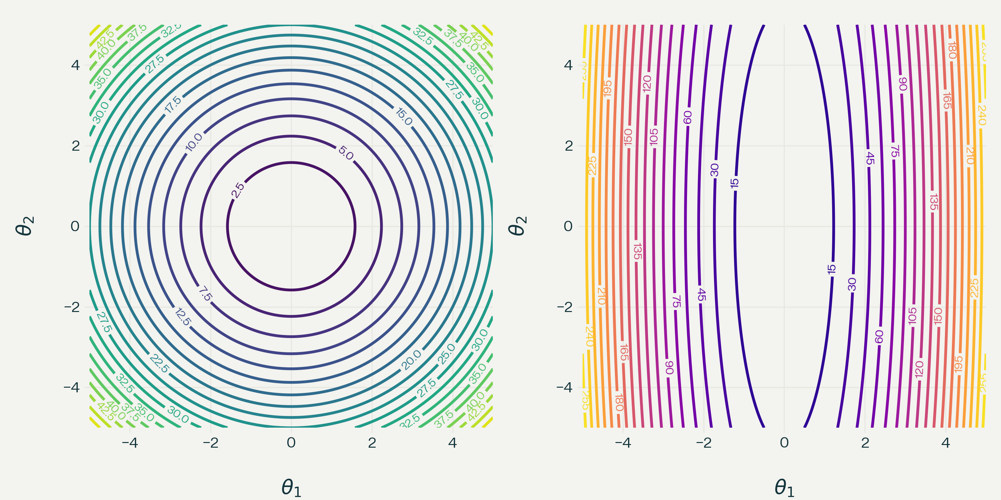
Well-conditioned loss surface
ILL-conditioned loss surface
Remedies to overcome the ill-conditioning :momentum and adaptive optimizers

Slide 62
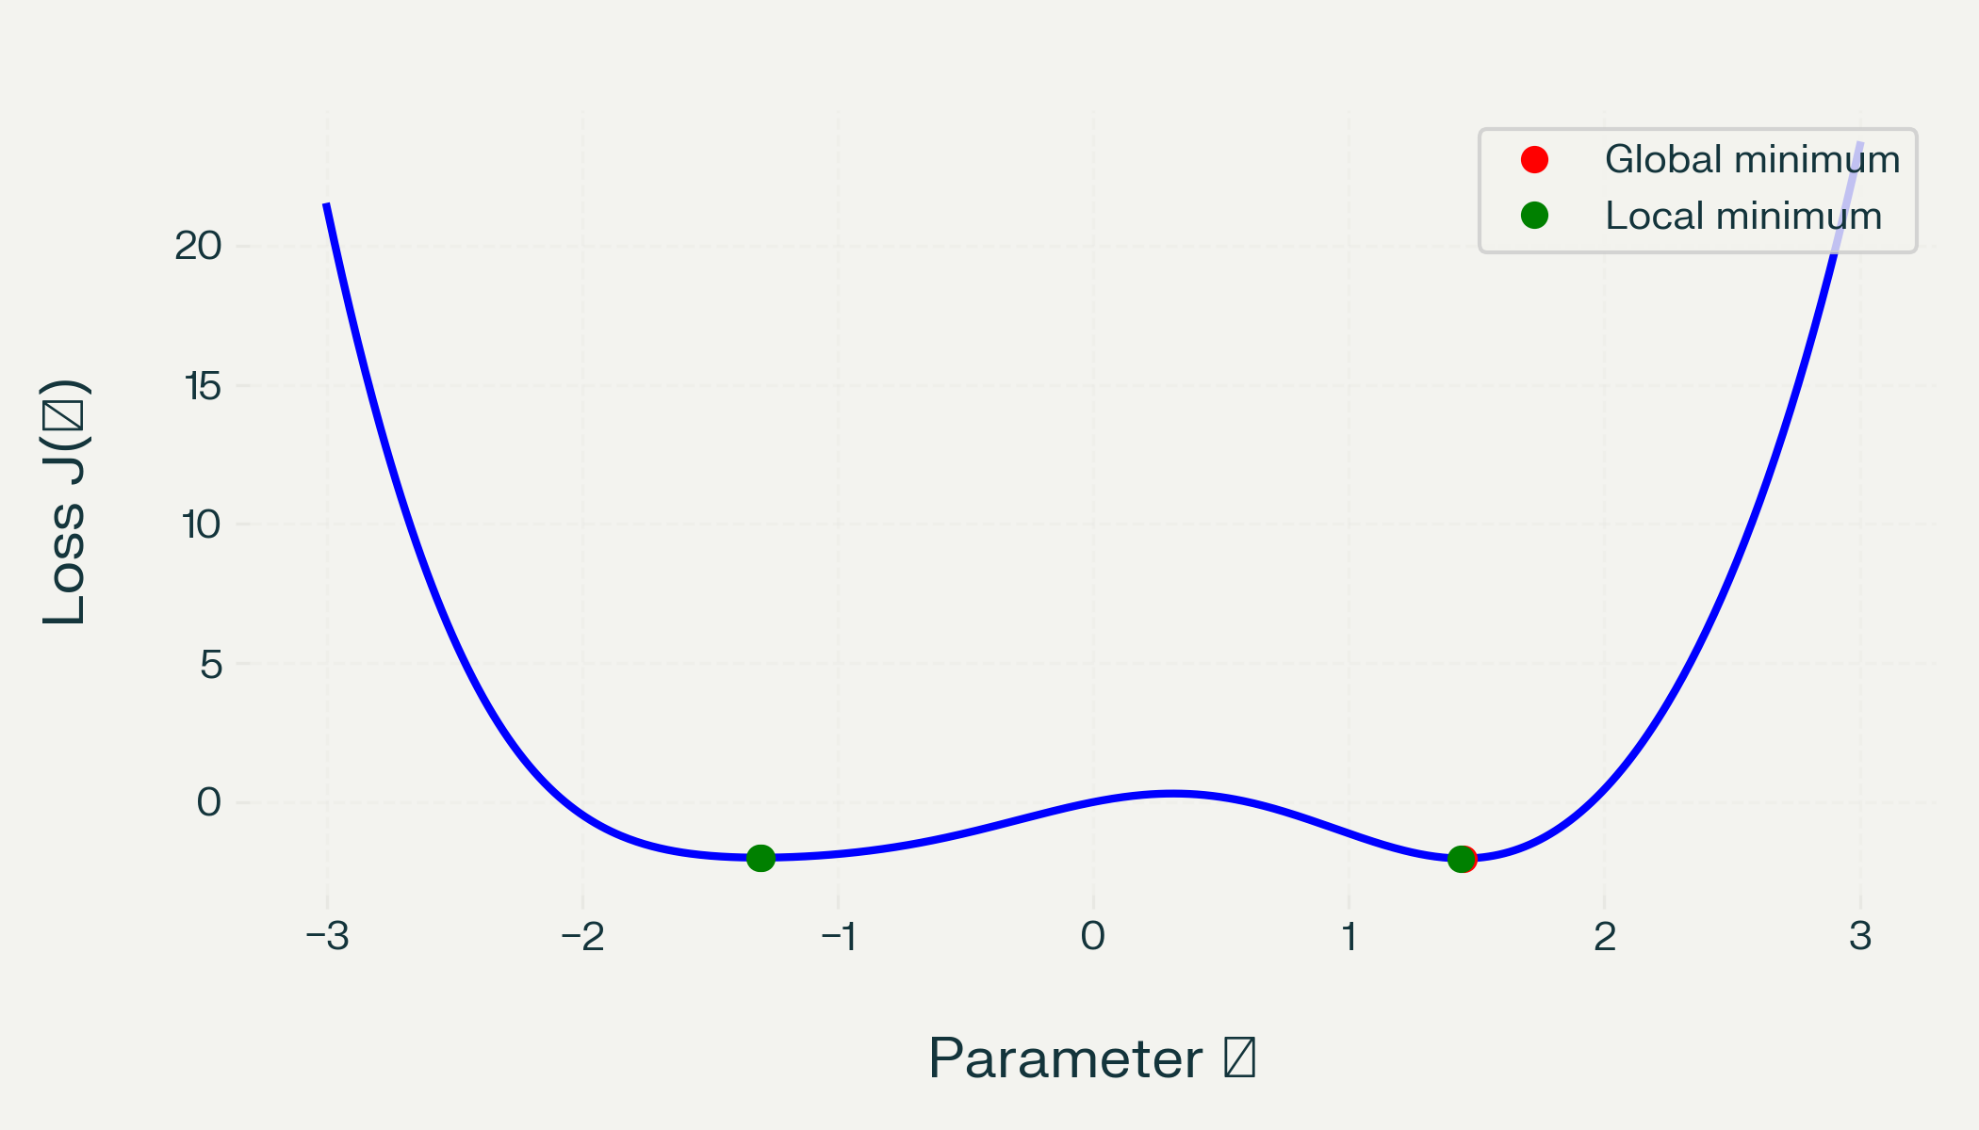

LOCAL MINIMA

Slide 63
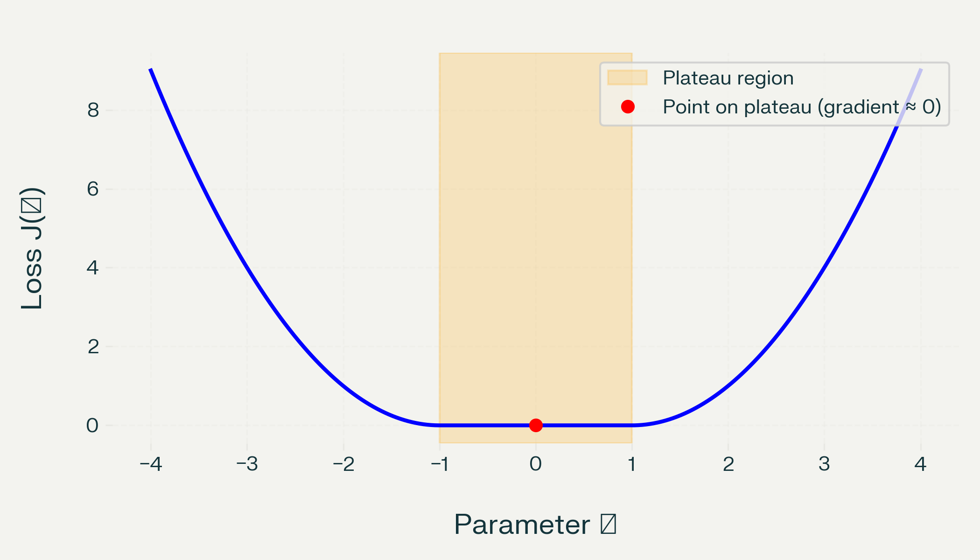
PLATEUS
VANISHING GRADIENTS → Extremely slow learning

Slide 64
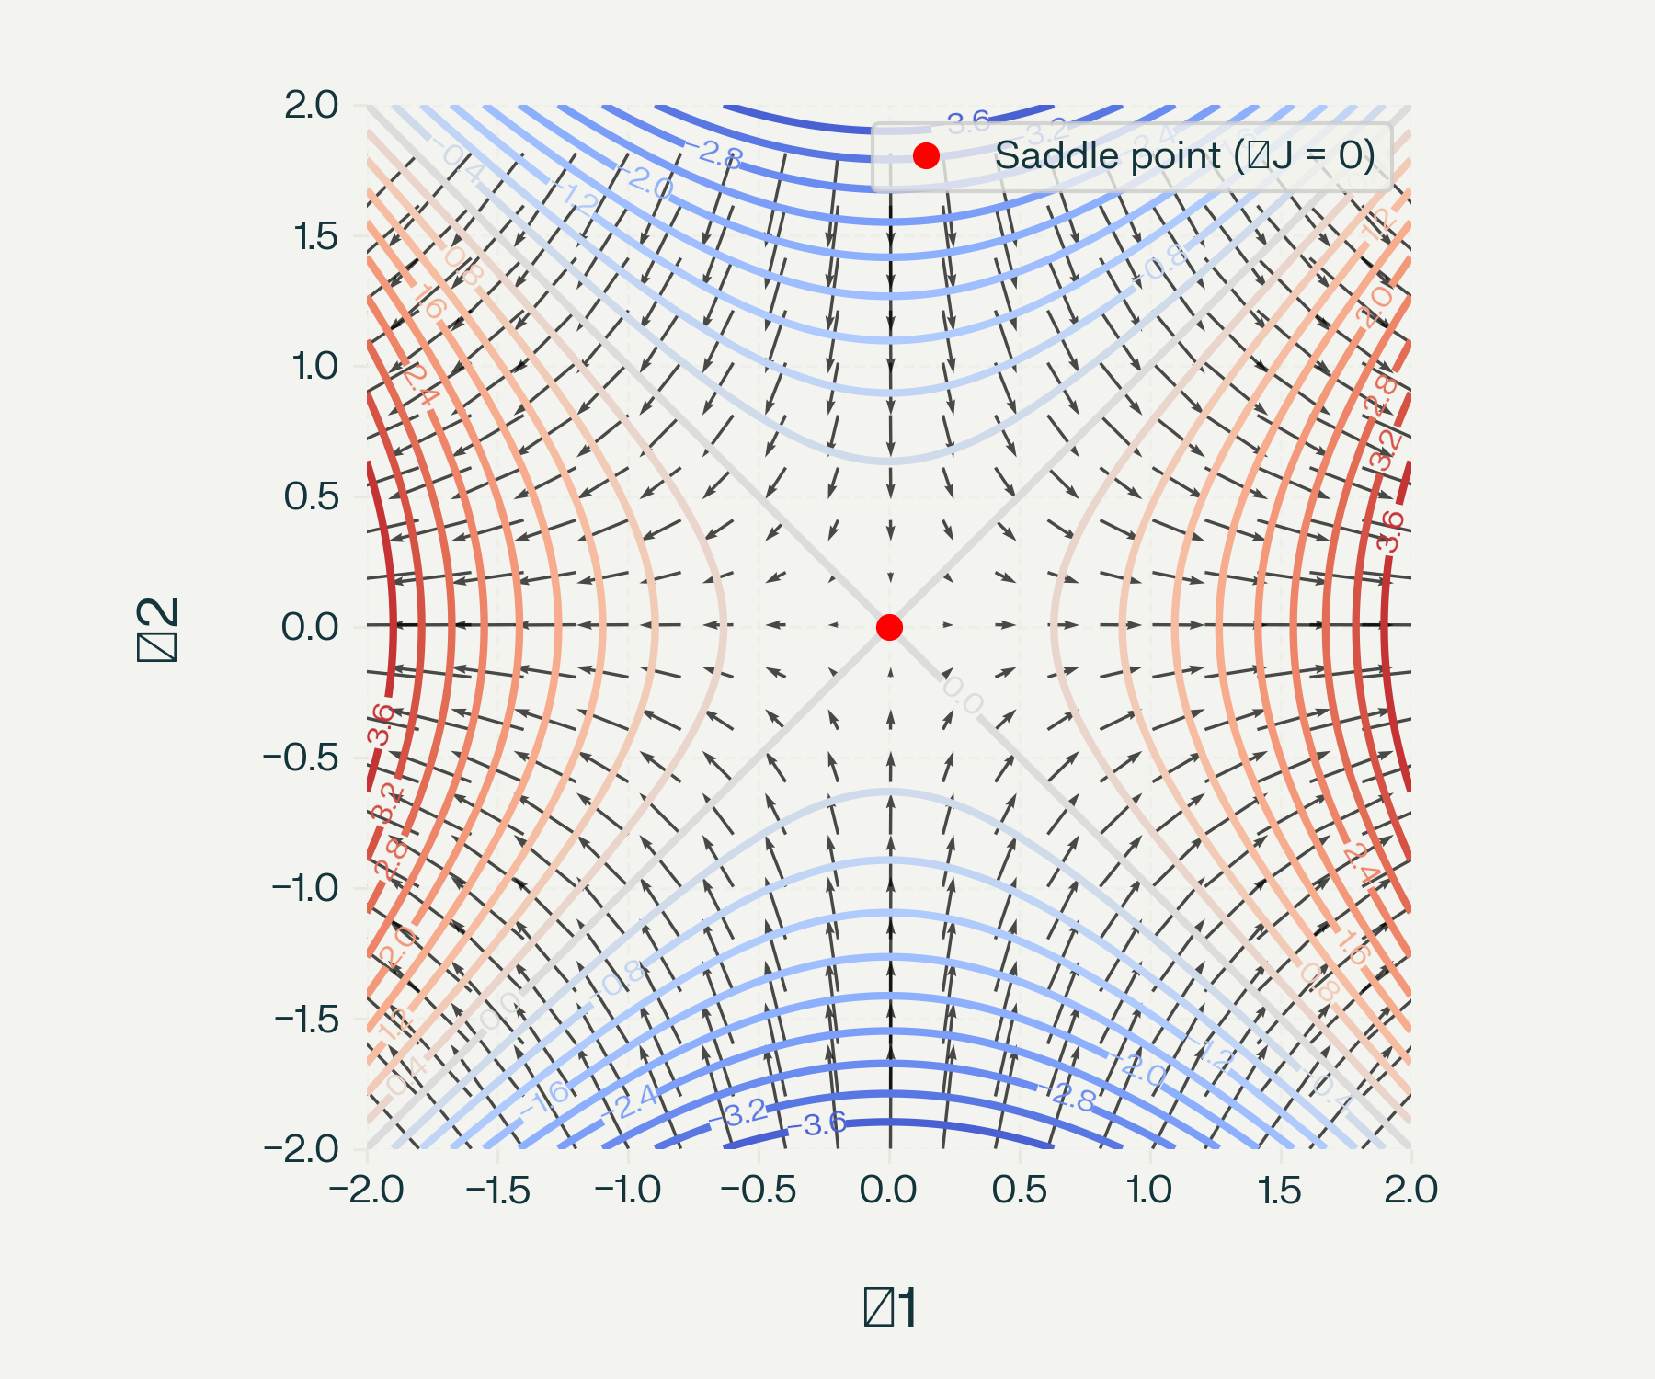
SADDLE POINTS
Zero Gradient & mixed curvatures

Slide 65
Summarizing
Local minima: zero gradient at a valley bottom
Plateaus: large flat regions with near‑zero gradient
Saddle points: zero gradient, but mixed curvature (min in some directions, max in others)
Modern optimizers use:
Momentum (to carry through flat/saddle regions),
Adaptive methods (to rescale gradients per parameter),
And sometimes second‑order or curvature‑inspired ideas (conceptually).

